Slide 1
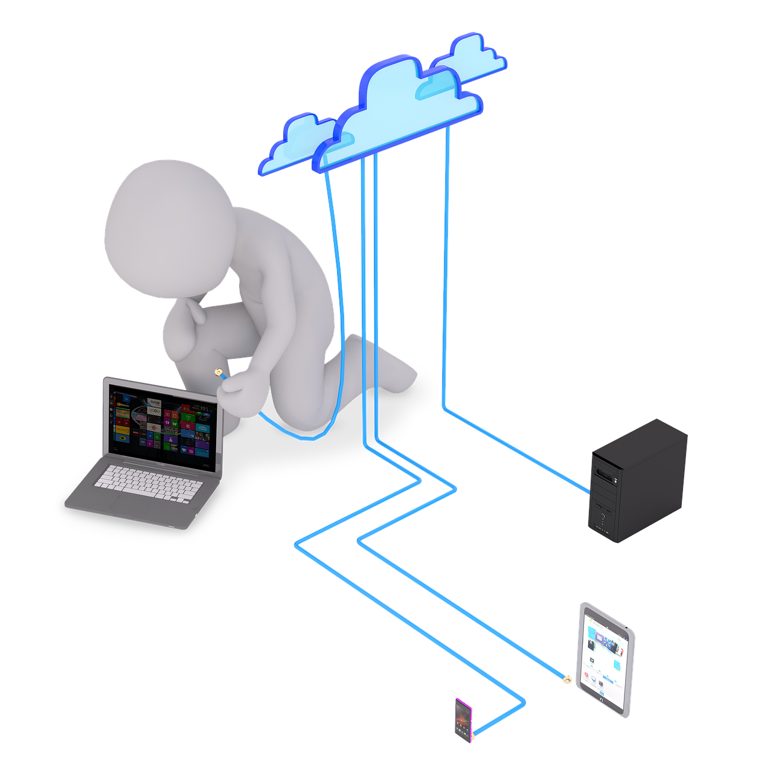
NAVTTC ASSIGMENT
By IRFAN ALI

Slide 2

WELLCOME:

Slide 3
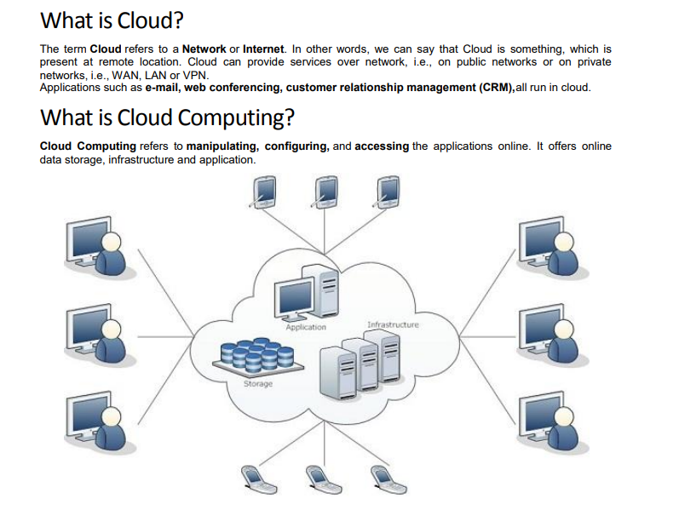

Slide 4
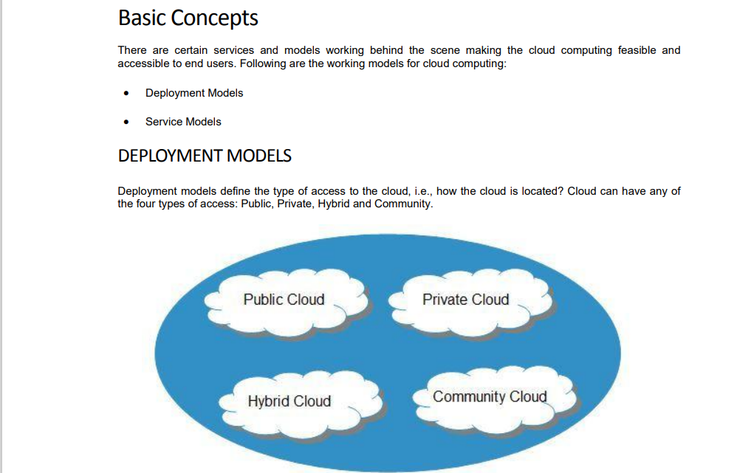

Slide 5
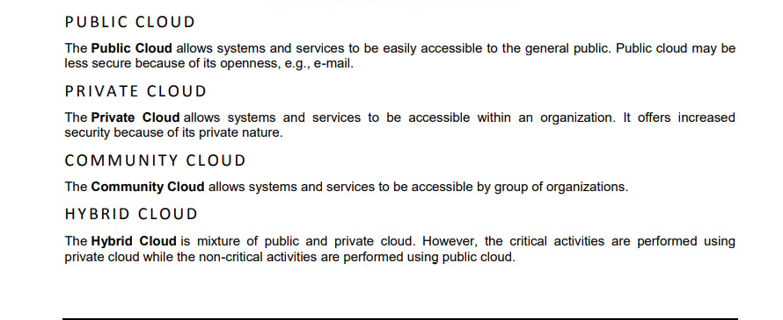
DEPLOYMENT METHOD:

Slide 6
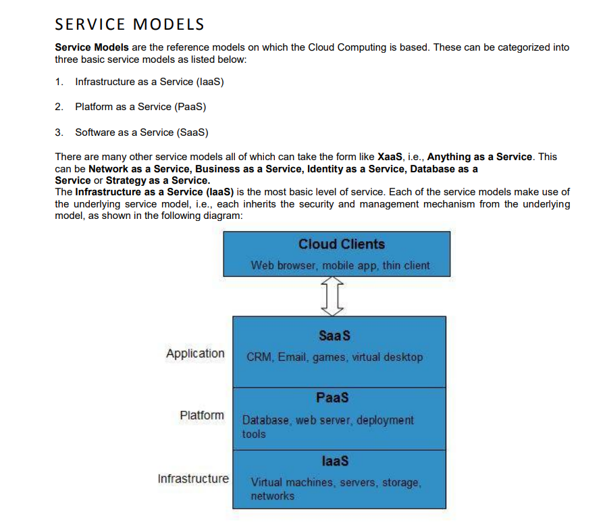

Slide 7
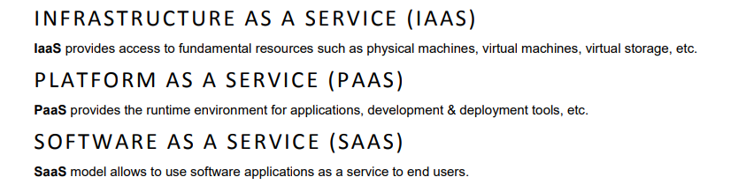
SERVICE MODEL

Slide 8
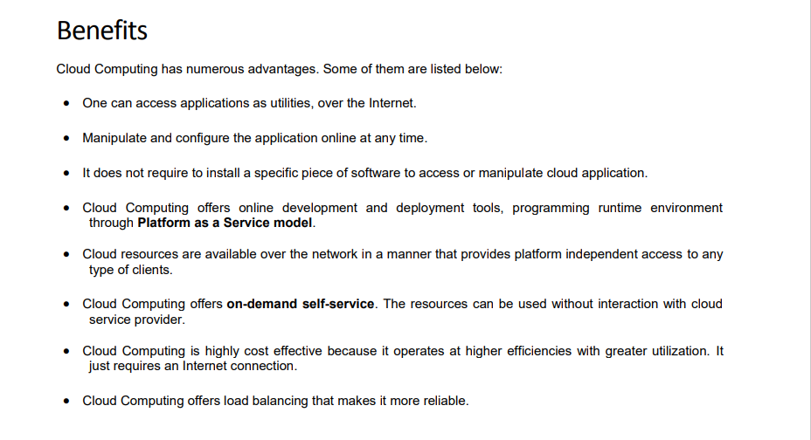

Slide 9

THANK YOU FOR WATCHING

